Slide 1
Quality Circle Forum of India
presents
Problem Solving Techniques
- a simplified revised practical guide

Slide 2


Slide 3
What is Histogram?
Histogram is a graphical representation of a frequency distribution which is a summary variation in a product or process.
30
25
20
FREQUENCY
15
10
5
0
WEIGHT (gms)

Slide 4

Dr.W.A. Shewhart, a physicist from Bell Laboratories explained about variations in 1931, in his publication of "Economic Control of Quality of Manufactured Product".
Economic
Control of
Quality of
Manufactured
Product

Slide 5
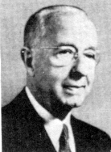
Dr. W. A.Shewhart explains that however sophisticated a process may be it will be impossible to produce two products identically same.

Slide 6
Various inputs which go in for an output have their inherent variations.
For example in case of a product output

Slide 7
Raw material used have variation

Slide 8
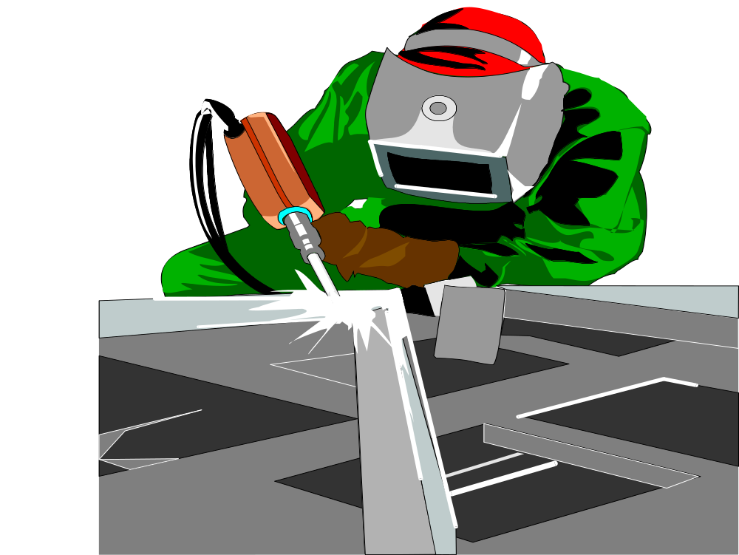
Process conditions have variation

Slide 9
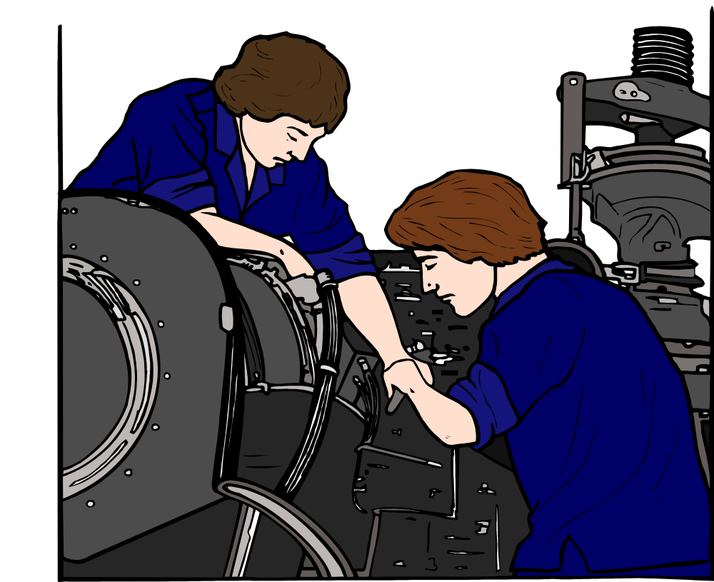
Machine condition and functioning have variations

Slide 10

Obviously the output will have variation.

Slide 11
Chance cause
Upper
control
Limit
Central
Line
Lower
control
Limit
He defined the problem of managing quality as one of differentiating between acceptable variation or chance causes.

Slide 12
Assignable cause
Upper
control
Limit
Central
Line
Lower
control
Limit
and unacceptable variation, or assignable causes.

Slide 13
Both the causes produce variation, but one has to live with chance causes as they can never be fully eliminated but they allow the process to function within predictable level of variation
Dr. W.A. Shewart

Slide 14

Mathematical Formula
to establish
Boundaries of Variation
Using mathematical formula he established boundaries of
variation for a given process

Slide 15
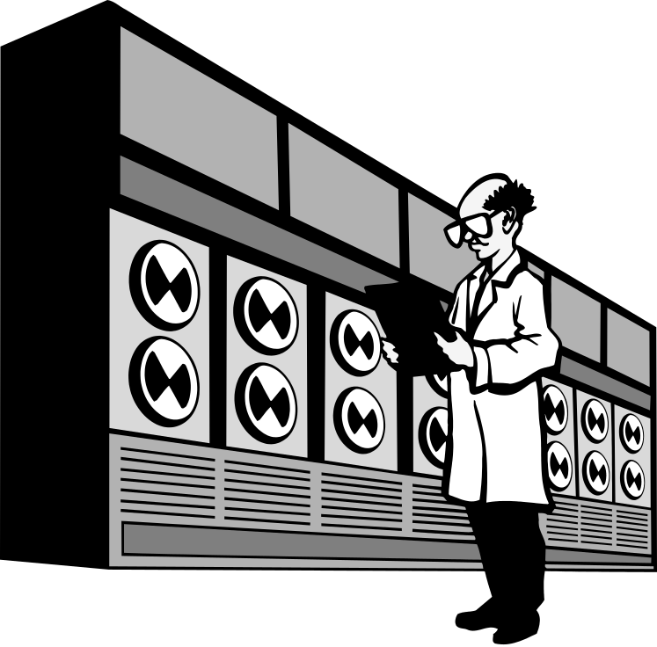
Persons in the concerned process area can collect samples at regular intervals and plot the results on a chart. This chart helps to measure the stability of the process over time.

Slide 16
Control Chart
Upper
control
Limit
Central
Line
Lower
control
Limit
This is called Control Chart and to know more about it refer to the technique 'Control Chart’.

Slide 17
Histogram belongs to the same family and helps us to keep track of the variations.

Slide 18
45
10-15
40
15-20
35
20-25
30
No of crimes
25-30
25
30-35
20
35-40
15
40-45
10
45-50
5
50-55
0
AGE OF CRIMINAL
It is basically a graphical presentation of series of measurement grouped into continuous classes or intervals.

Slide 19
In this case the spread of measurement is from 142gms to 158 gms
30
25
142
144
20
146
148
15
150
FREQUENCY
152
10
154
156
5
158
0
WEIGHT OF SOAP (gms)
This shows about a process
a) The spread of measurement

Slide 20
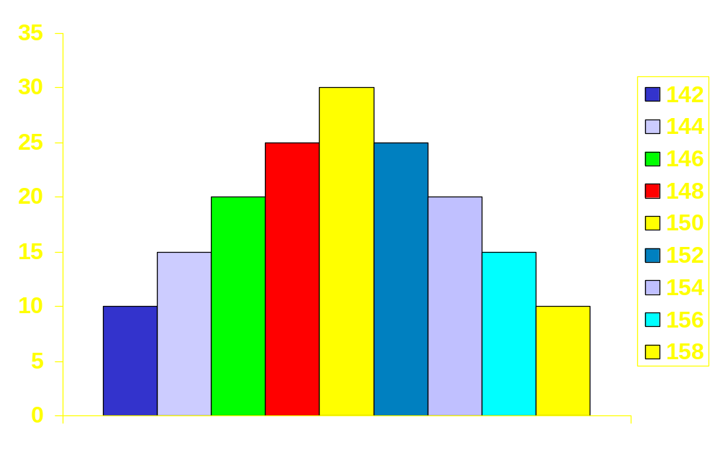
In this case the no. of soaps on the mean value (150gms) is 30 nos.
FREQUENCY
WEIGHT OF SOAP (gms)
b) How many of each measure there are

Slide 21
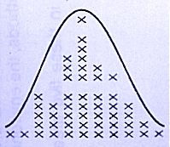
c) The level of process setting

Slide 22

By such study we can find out the process capability at various times.

Slide 23
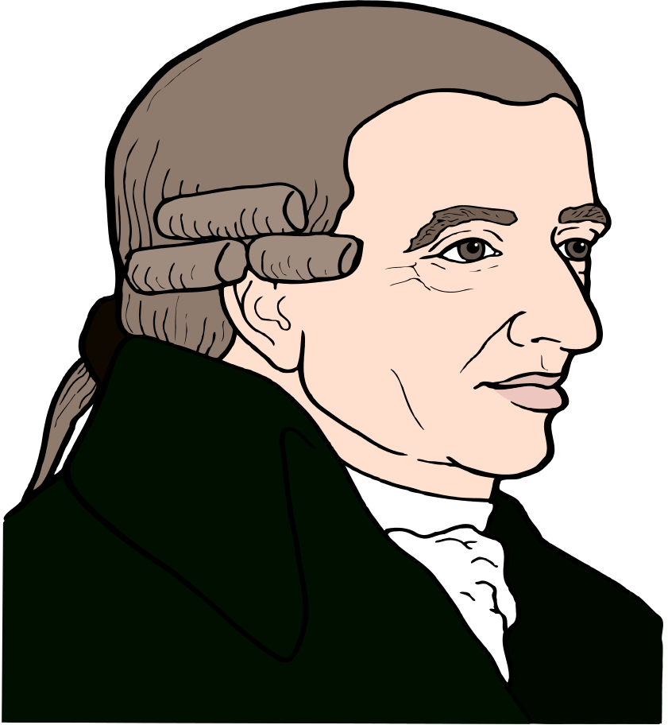
Mr.A.M. Gurrey a French statesman is credited with this.

Slide 24
45
10-15
40
15-20
35
20-25
30
25-30
25
No of crimes
30-35
20
35-40
15
40-45
10
45-50
5
50-55
0
He studied through bar graph the relation of number of crimes committed to the continuous variable like age of the criminal etc.,

Slide 25
45
10-15
40
15-20
35
No of crimes
20-25
30
25-30
25
30-35
20
35-40
15
40-45
10
45-50
5
50-55
0
He could convincingly establish the relationship and arrive at a conclusion from it.

Slide 26
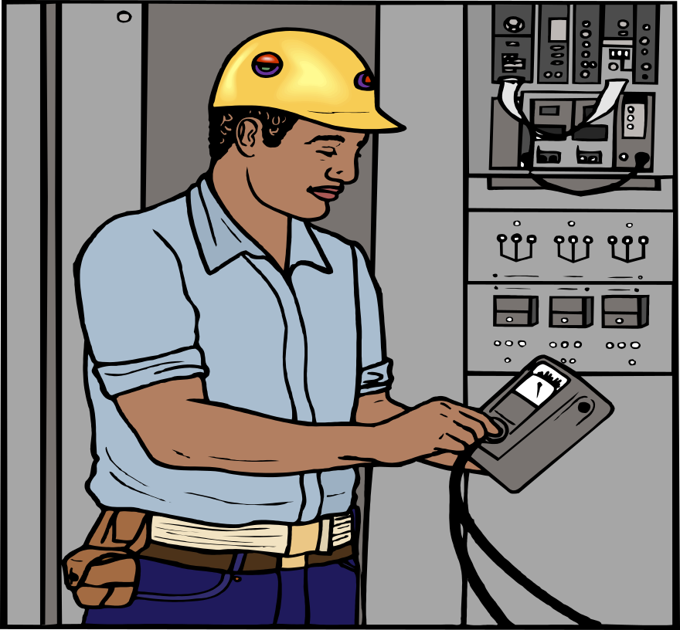
The basis or guide for action is data. When data are collected, it is viewed as a sample of all possible observations from a process.

Slide 27
POWER CONSUMPTION (kWh) OF REFRIGERATOR
1.97 2.49 2.29 2.24 2.42 2.16 2.89 1.75 2.24 2.07 2.20 2.52 2.32 2.10 1.98 1.96 2.16 1.94 2.13 2.43 2.45 1.76 1.91 2.06 2.04 2.52 2.02 1.95 2.31 2.16 2.00 1.96 2.00 2.29 2.33 2.08 2.23 2.05 1.92 2.25 2.36 1.87 1.95 1.92 2.14 2.08 2.17 2.13 2.08 1.92 2.04 2.00 2.08 1.86 2.34 2.05 2.04 2.16 1.74 1.96 1.83 1.95 2.17 2.02 2.23 2.07 2.08 2.64 2.17 2.02
The totality of all possible observations we can think of, is called ‘Population’.

Slide 28
POWER CONSUMPTION (KWH) OF REFRIGERATOR
1.97 2.49 2.29 2.24 2.42 2.16 2.89 1.75
2.24 2.07 2.20 2.52
Few observations taken is called ‘Sample’.

Slide 29
Why do we need such information?

Slide 30
Even though we accept that process has variation, we want the product to be around the target value on average.

Slide 31
DELUXE SOAP
For example in a plant which manufactures soap the weight of the soap is checked as one of the parameters.

Slide 32
152.55
The expected weight is 150 grams and taking variation into account specification is fixed as 150 10 grams i.e. we are ready to accept the weight of the soap ranging from 140 to 160 grams.
_
+

Slide 33
Skewed Positive
90
80
144
70
146
60
148
50
150
FREQUENCY
152
40
154
30
156
20
158
160
10
0
WEIGHT (gms)
Even though this may be acceptable level if the weights are continuously on the higher side i.e. say 155,152,156,157 etc., we will make adjustment in the process to bring back to the target value.

Slide 34
Skewed Negative
80
70
140
60
142
144
50
146
40
148
FREQUENCY
30
150
152
20
154
10
156
0
WEIGHT (gms)
Similarly if this weights are consistently on the lower side i.e. 142,143,144,145,147,148 we will increase the weight

Slide 35
In other words, we
want maximum number of items on the target
i.e. at 150 grams
and on both sides
lesser and lesser
as one goes
farther and farther.

Slide 36
In other words, the expected readings for 100 nos may be as follows
Weight (in grams) Frequency
142 grams 4
144 grams 8
146 grams 10
148 grams 18
150 grams 25
152 grams 17
154 grams 9
156 grams 7
158 grams 2
Total 100

Slide 37
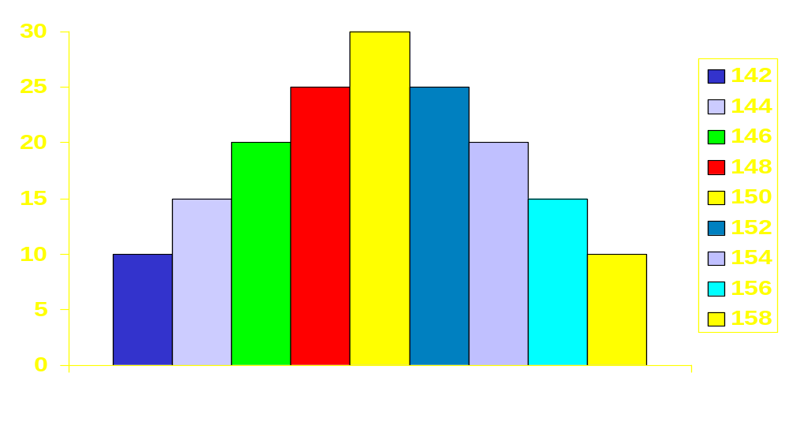
FREQUENCY
WEIGHT (gms)
When a process is like this we call it "normal distribution" (bell Shaped) and consider the process is under control.

Slide 38
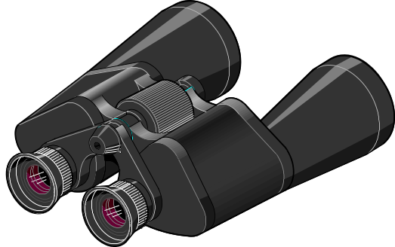
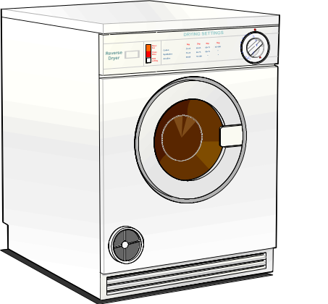
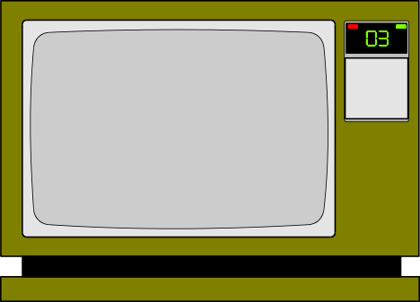



The allowable level for variation depends upon the
nature of the product.

Slide 39



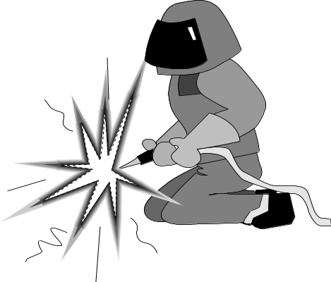

Types of service expected of it.

Slide 40

Statutory agreement

Slide 41
Market condition etc.,

Slide 42
When we look at a Histogram we want the answer for
Bell shaped curve
a) is the process producing components to the bell shaped curve?

Slide 43

b) Where is the process centered?

Slide 44

I do not think that the process is capable of meeting the specification. The histogram looks asymmetrical.
c) Is the process capable of meeting the specification?

Slide 45

The process appears to be normal and stable. Look at the histogram it is bell shaped.

Slide 46

Variation in that process are due to chance causes.

Slide 47
If it is otherwise we say that the process is not normal and hence not under control.

Slide 48

Assignable causes are influencing the variations.

Slide 49
Min
Max
Specification Limit
30
25
20
15
10
5
0
If the process is centred around the mid point of specification then we say the process is well centred.

Slide 50
If the average is away from mid-specification, the process setting needs adjustment.

Slide 51

I think we will have to make a few adjustments to decrease the diameter of the ball bearing
Similarly if the process is falling within the specification limit then we say that it is capable of meeting the specification requirement.

Slide 52
HOW
TO
CONSTRUCT
A
HISTOGRAM

Slide 53
Procedure
For example consider the 100 readings of power consumption of refrigerators given
Let us call each observation as ‘X’

Slide 54
POWER CONSUMPTION (KWH) OF REFRIGERATOR
1.97 2.49 2.29 2.24 2.42 2.16 2.89 1.75
2.24 2.07 2.20 2.52 2.32 2.10 1.98 1.96 2.16 1.94 2.13 2.43 2.45 1.76 1.91 2.06 2.04 2.52 2.02 1.95
2.31 2.16 2.00 1.96 2.00 2.29 2.33 2.08 2.23 2.05 1.92 2.25 2.36 1.87 1.95 1.92 2.14 2.08 2.17 2.13 2.08 1.92 2.04 2.00 2.08 1.86 2.34 2.05 2.04 2.16 1.74 1.96 1.83 1.95 2.17 2.02 2.23 2.07 2.08 2.64 2.17 2.02

Slide 55
Next we have to put these readings into subgroups. For that purpose we should know the lowest and highest value of the readings.

Slide 56
POWER CONSUMPTION (KWH) OF REFRIGERATOR
1.97 2.49 2.29 2.24 2.42 2.16 2.89 1.75 2.24 2.07
2.20 2.52 2.32 2.10 1.98 1.96 2.16 1.94 2.13 2.43
2.45 1.76 1.91 2.06 2.04 2.52 2.02 1.95 2.31 2.16
2.00 1.96 2.00 2.29 2.33 2.08 2.23 2.05 1.92 2.25
2.36 1.87 1.95 1.92 2.14 2.08 2.17 2.13 2.08 1.92
2.04 2.00 2.08 1.86 2.34 2.05 2.04 2.16 1.74 1.96
1.83 1.95 2.17 2.02 2.23 2.07 2.08 2.64 2.17 2.02
2.45 1.76 1.91 2.06 2.04 2.52 2.02 1.95 2.31 2.16
2.00 1.96 2.00 2.29 2.33 2.08 2.23 2.05 1.92 2.25
2.36 1.87 1.95 1.92 2.14 2.08 2.17 2.13 2.08 1.92
Easy way of finding that is putting these figures in 10 rows with 10 figures in each.

Slide 57
POWER CONSUMPTION (KWH) OF REFRIGERATOR
1.97 2.49 2.29 2.24 2.42 2.16 2.89 1.75 2.24 2.07
2.20 2.52 2.32 2.10 1.98 1.96 2.16 1.94 2.13 2.43
2.45 1.76 1.91 2.06 2.04 2.52 2.02 1.95 2.31 2.16
2.00 1.96 2.00 2.29 2.33 2.08 2.23 2.05 1.92 2.25
2.36 1.87 1.95 1.92 2.14 2.08 2.17 2.13 2.08 1.92
2.04 2.00 2.08 1.86 2.34 2.05 2.04 2.16 1.74 1.96
1.83 1.95 2.17 2.02 2.23 2.07 2.08 2.64 2.17 2.02
2.45 1.76 1.91 2.06 2.04 2.52 2.02 1.95 2.31 2.16
2.00 1.96 2.00 2.29 2.33 2.08 2.23 2.05 1.92 2.25
2.36 1.87 1.95 1.92 2.14 2.08 2.17 2.13 2.08 1.92
Find out the lowest and highest value in each row and mark them as Xs and XL.

Slide 58
Write them as follows
Row Xs XL
1. 1.75 2.31
2. 1.84 2.49
3. 1.89 2.23
4. 1.74 2.29
5. 1.94 2.24
6. 1.91 2.28
7. 1.83 2.64
8. 1.93 2.54
9. 1.95 2.46
10. 1.87 2.56

Slide 59
Mark the lowest among Xs and highest value among XL
Row Xs XL
1. 1.75 2.31
2. 1.84 2.49
3. 1.89 2.23
4. 1.74 2.29
5. 1.94 2.24
6. 1.91 2.28
7. 1.83 2.64
8. 1.93 2.54
9. 1.95 2.46
10. 1.87 2.45
They are the lowest and highest value of the group.i.e. X min is 1.74 and X max is 2.64

Slide 60
Compute the range
R = X max - X min
R = 2.64 - 1.74
= 0.90

Slide 61
Given here is the standard table for number of classes or groups
Number of Recommended
Observations No of classes or (N) groups (K)
< 50 6
51 - 100 7
101 - 200 8
201 - 500 9
501 - 1000 10
Here N = 100
therefore K = 7

Slide 62
Calculate the approximate width of class intervals based on the formula (R+W) / K where
'R' = range = 0.90
'W' = accuracy in observation = 0.01
and
'K' = No.of classes = 7

Slide 63
Based on that, the width of class interval is
R + W 0.90 + 0.01
K 7
= 0.13
C
=
=

Slide 64
Now specify the class boundaries.
The lower limit of the first class is
=X min - 0.5 W
= 1.74 - 0.005 = 1.735
The Upper limit of the first class is
= 1.735 + C
= 1.735 + 0.13
= 1.865

Slide 65
Subsequent classes are obtained by adding class width 'C’.
We have to ensure that
a) Classes are continuous
b) All classes have same width C.

Slide 66
Based on that we get
1.735 - 1.865
1.865 - 1.995
1.995 - 2.125
2.125 - 2.255
2.255 - 2.385
2.385 - 2.515
2.515 - 2.645

Slide 67
Class Tally
1.735 - 1.865 //// /
1.865 - 1.995 //// //// //// //// //// /
1.995 - 2.125 //// //// //// //// ////
2.125 - 2.225 //// //// //// //// ////
2.225 - 2.255 //// ///
2.385 - 2.515 //// /
2.515 - 2.645 ////
Now prepare a table as shown and enter the observation in an order and for each observation put a mark against the interval containing that value.

Slide 68
Class Tally Frequency
1.735 - 1.865 //// / = 6
1.865 - 1.995 //// //// //// //// //// / = 26
1.995 - 2.125 //// //// //// //// //// = 25
2.125 - 2.225 //// //// //// //// //// = 25
2.225 - 2.255 //// /// = 8
2.385 - 2.515 //// / = 6
2.515 - 2.645 //// = 4
Count the total number of tally marks to give the frequency of that class. This gives frequency table.

Slide 69
To draw the Histogram for the above frequency table, proceed
as follows:

Slide 70
1.54 1.67 1.80 1.93 2.06 2.19 2.32 2.45 2.58 2.71
Power Consumption
a) Take a graph paper and represent energy consumption on the `X' axis

Slide 71
28
24
20
Frequency
16
12
8
4
0
1.54 1.67 1.80 1.93 2.06 2.19 2.32 2.45 2.58 2.71
Power Consumption
and frequency on the Y axis by choosing a suitable scale.

Slide 72
Mark the classes on the 'X' axis with class intervals. Erect a rectangle with class interval as base whose height is equal to the frequency.
The resulting diagram is the Histogram.

Slide 73
28
24
20
Frequency
16
12
8
4
6 26 25 25 8 6 4
0
1.54 1.67 1.80 1.93 2.06 2.19 2.32 2.45 2.58 2.71
Power Consumption

Slide 74
Lower
spec.
Limit
Upper
spec.
Limit
28
24
20
Frequency
16
12
8
4
6 26 25 25 8 6 4
0
1.54 1.67 1.80 1.93 2.06 2.19 2.32 2.45 2.58 2.71
Show the specification limits, if given.

Slide 75
Lower
spec.
Limit
Upper
spec.
Limit
28
24
20
Frequency
16
12
8
4
6 26 25 25 8 6 4
0
1.54 1.67 1.80 1.93 2.06 2.19 2.32 2.45 2.58 2.71
Darken or shadow the portion beyond the specification limits.

Slide 76
Interpretation of the Histogram
Histogram shows the pattern of variation. By looking at the Histogram, information on the following can be obtained.

Slide 77
35
Mean Value
30
142
144
25
146
20
148
150
15
152
154
10
156
5
158
0
a) Location of mean value i.e. process level

Slide 78
Spread in the process
50
45
10-15
40
15-20
35
20-25
30
25-30
25
30-35
No of crimes
20
35-40
15
40-45
10
45-50
5
50-55
0
AGE OF CRIMINAL
b) Extent of variation or spread in the process

Slide 79
Symmetrical Histogram
Skewed Negative Histogram
c) Pattern of variation given by the shape of the Histogram - Symmetrical or skew?

Slide 80
Lower
spec.
Limit
Upper
spec.
Limit
28
24
20
Frequency
16
12
8
4
6 26 25 25 8 6 4
0
1.54 1.67 1.80 1.93 2.06 2.19 2.32 2.45 2.58 2.71
Power Consumption
d) Conformance to prescribed specifications

Slide 81
Min
Max
Specification Limit
30
25
20
15
10
5
0
e) Whether the process is under statistical control or not.

Slide 82
Some Caution
20
18
16
14
12
Frequency
10
8
6
4
2
0
10 20 35 65 95
Salaries (Rs 1000)
Use equal width intervals
Do not use unequal intervals - Resulting diagram will be confusing.

Slide 83
Some Caution
20
18
16
14
Frequency
12
10
8
6
4
2
0
10 20 30 40+
Salaries (Rs 1000)
Do not use open intervals That is, make sure every interval has definite boundaries.

Slide 84
Some Caution
210
200
30
20
10
0
Frequency
10 20 30 40 50 90 100
Receipts
Do not make any break in the vertical or horizontal scales

Slide 85
Some Caution
35
30
25
20
15
60
10
5
50
0
40
Too few
30
20
10
0
Too many
Do not have too few or too many intervals

Slide 86
Identify all the information completely to make the graph understandable.

Slide 87
Lower
spec.
Limit
Upper
spec.
Limit
28
24
20
16
Frequency
12
8
4
0
1.54 1.67 1.80 1.93 2.06 2.19 2.32 2.45 2.58 2.71
Power Consumption

Slide 88
Some Caution
When a major decision needs to be taken it is always advisable to check up the basic data in order of time. Because sometimes

Slide 89
A data like this can give a Symmetrical Histogram
Time
But this is a trend

Slide 90
A data like this can also give a Symmetrical Histogram
Time
But this is a run

Slide 91
Some of the Shapes of Histogram

Slide 92
Asymmetrical i.e. skewed Positive.
Asymmetrical with more observation to the right of mean. Such patterns may result from measurements on characteristics like ovality, taper etc. Also data on accidents, defects etc. may give rise to this type of histogram.

Slide 93
Asymmetrical Skewed Negative
This is with more observations to the left of the mean

Slide 94
Cliff like Histogram
This is a truncated type. Frequencies drop abruptly on the left. This may arise when parts are inspected and those below lower specification limits are removed and the lot is re-inspected.Similarly, truncation can be on right side (corresponding to upper specification limit)

Slide 95
Double Peaked
This pattern arises from a mixture of two conditions , two suppliers of same parts, two machines, two operators. Separate histogram for each condition has to be made.

Slide 96
Comb Type
This pattern is usually traceable to errors in measurements, and observations are rounded off. Check for bias for even numbers in the data.

Slide 97
Isolated Peak
It is small group of data from a different lot/process condition. It shows that means or process levels are different and variation is different.

Slide 98
Plateau Type
This is a mixture of several process conditions. Output of several days mixed together in a lot.

Slide 99

Uses of Histogram:
To know the pattern of variation

Slide 100
Uses of Histogram:
To assess status of control
Lower
spec.
Limit
Upper
spec.
Limit
28
24
20
Frequency
16
12
8
4
0
1.54 1.67 1.80 1.93 2.06 2.19 2.32 2.45 2.58 2.71
Power Consumption

Slide 101
Uses of Histogram:
Lower
spec.
Limit
Upper
spec.
Limit
28
24
20
Frequency
16
12
8
4
0
1.54 1.67 1.80 1.93 2.06 2.19 2.32 2.45 2.58 2.71
Power Consumption
To assess conformance to specifications

Slide 102
Uses of Histogram:
Spread in the process
45
10-15
40
15-20
35
No of crimes
20-25
30
25-30
25
30-35
20
35-40
15
40-45
10
45-50
5
50-55
0
AGE OF CRIMINAL
To assess spread or variation with reference to specification

Slide 103
Uses of Histogram:
To assess process capability

Slide 104

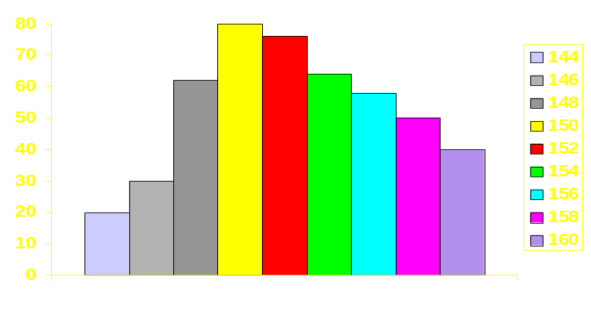
Uses of Histogram:
We may have to adjust the process to reduce weight.. The weight of the soap is continuously on the higher side
Weight of soap
To get clues for bringing process under control - whether to shift mean or to reduce variation or both

Slide 105
Uses of Histogram:
Double Peaked Histogram
To get clues for possible assignable causes for observed variation - mixture of lots, suppliers,

Slide 106
Uses of Histogram:
Comb Type Histogram
instrument/measurement errors, bias of written results etc

Slide 107
Summary
Histogram
* Display variability in a set of data
* Patterns of variability reveal facts about process
* Patterns of variability can suggest and test theories
* Show the status of control
* Show current conformance to specifications and whether scope exists for improvement.

Slide 108

Prepared by
G. Vijaykumar

Slide 109


